Slide 1
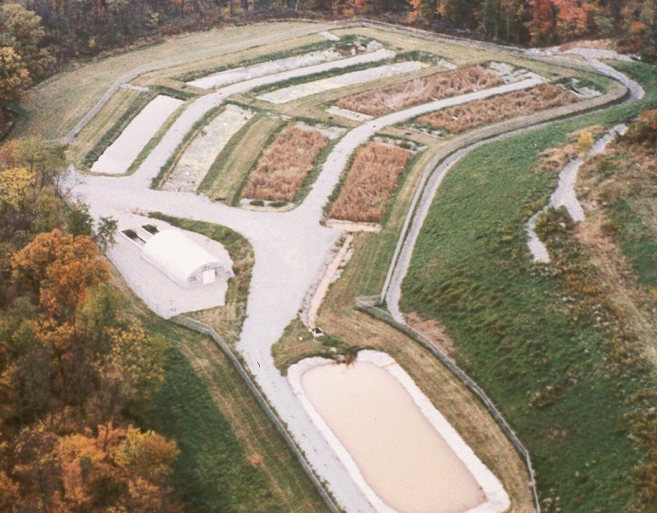
The Evolving Role of Constructed Wetlands in Remedial Wastewater Treatment - A 25 Year Perspective
Presented to:
The Society of Wetland Scientists
Mid-Atlantic Chapter 2014 Conference
State College, Pennsylvania
April 5th, 2014
By:
Kevin L. Hoover, PG, PHGW, PWS
Water & Wetland Consulting, LLC
& Terry A Rightnour, PH, PWS
Water’s Edge Hydrology, Inc.

Slide 2
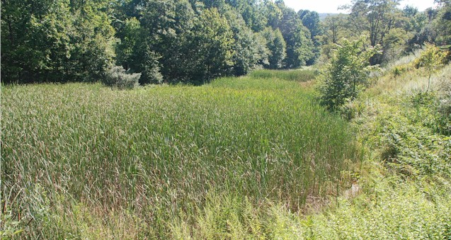
Origins of Constructed Wetland Treatment
General category of “passive” water treatment
Uses natural contaminant removal processes with little or no external power or reagent feeds
Developed in 1980s for abandoned mine drainage (AMD) and coal combustion residual (CCR) leachate
Based on observations that water quality improved passing through natural wetlands
Early designs focused
on replicating natural
vegetated systems
Water &
Wetlands Consulting
Water’s Edge Hydrology

Slide 3
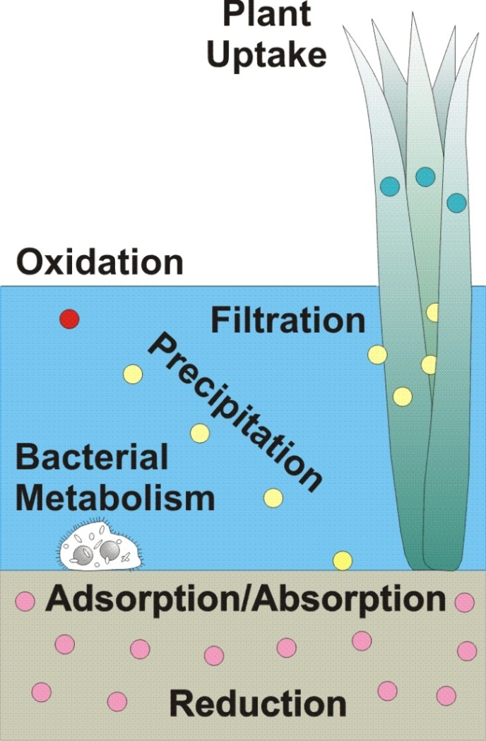
Constructed Wetland Treatment Concept
Vegetated wetlands provide a variety of functions
for contaminant removal
Many different Eh-pH
environments may be present
Natural swamps originally
trapped contaminants in coal
Constructed wetland treatment
seeks to replicate ore formation
processes
Water &
Wetlands Consulting
Water’s Edge Hydrology

Slide 4
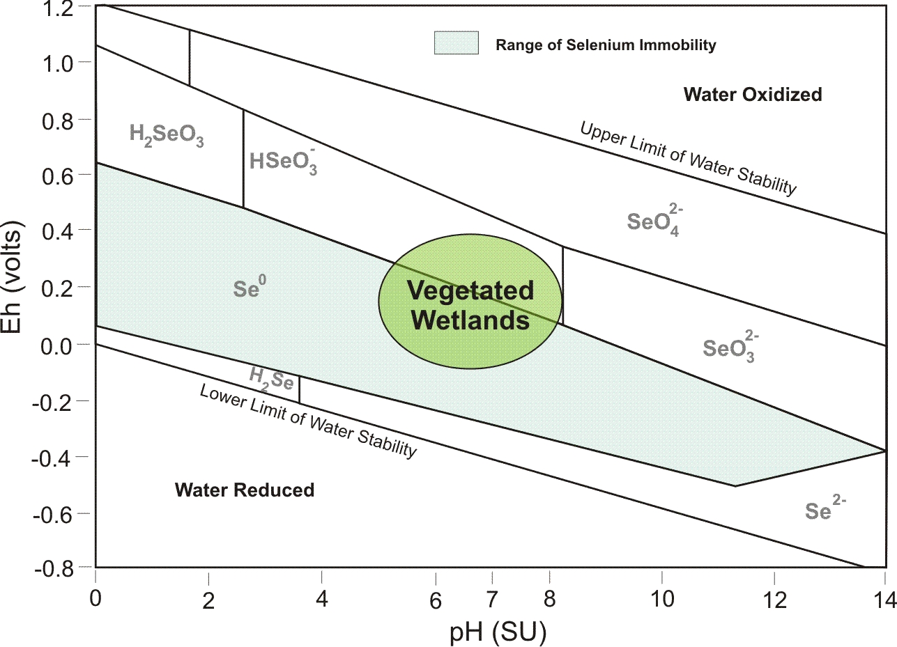
Limitations Encountered
Vegetated wetlands are not always effective for
parameters with narrow Eh-pH removal
ranges (Se, Mn,…)
Water &
Wetlands Consulting
Water’s Edge Hydrology

Slide 5
Phased Element Removal Technology (PERT)
Greater control needed for Eh-pH conditions
Research in 1990s isolated wetland treatment functions in targeted Eh-pH components
PERT design approach sequences components in preferred natural order of ore deposition
Allows more efficient sizing of components by predicting the discharge quality from each in sequence
Water &
Wetlands Consulting
Water’s Edge Hydrology

Slide 6
Basic PERT Design Components
Vertical Flow Limestone Beds (VLBs)
  Downflow beds of limestone to remove acidity
Oxidation/Precipitation Basins (OPBs)
  Settling basins with influent aeration
Surface Flow Wetlands (SFWs)
  Aerobic vegetated wetlands for metals removal
Organic Reduction Cells (ORCs)
  Downflow organic beds with strongly reducing conditions
Subsurface Flow Wetlands (SBWs)
  Vegetated wetlands with porous substrates for solids removal
Manganese-Oxidizing Beds (MOBs)
  Aerobic gravel beds colonizing Mn-oxidizing bacterial
Water &
Wetlands Consulting
Water’s Edge Hydrology

Slide 7
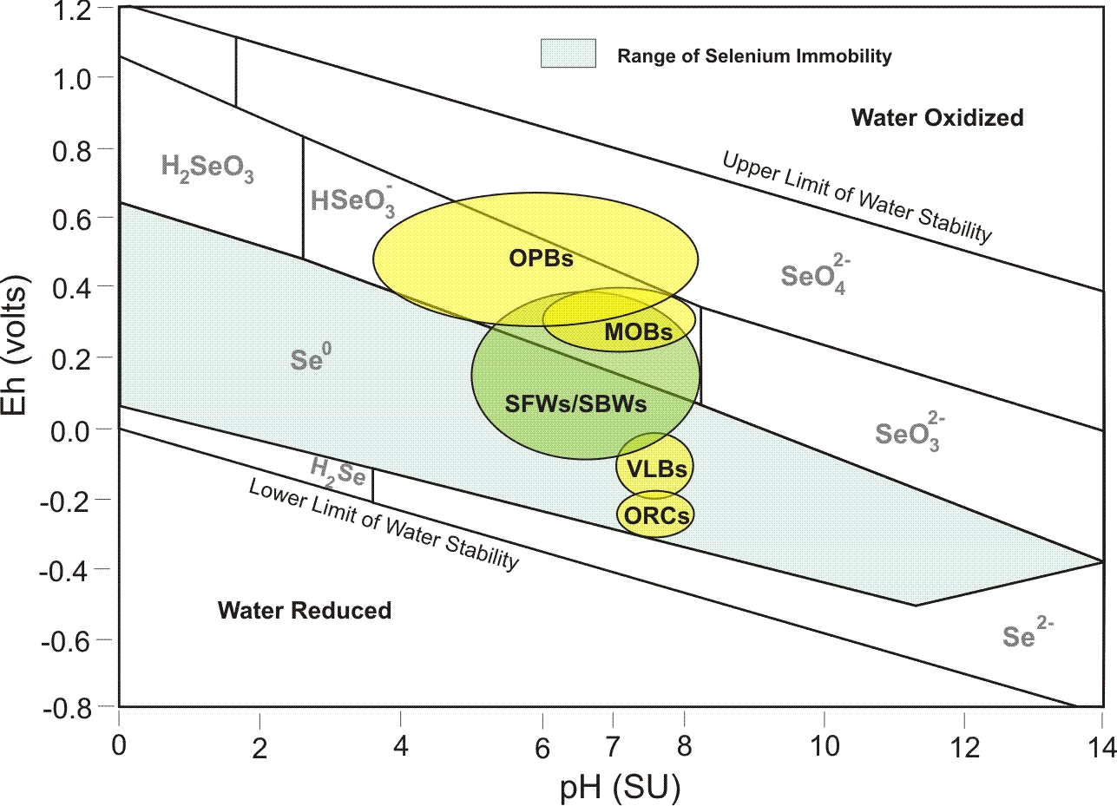
General Eh-pH Ranges for PERT Components
Water &
Wetlands Consulting
Water’s Edge Hydrology

Slide 8
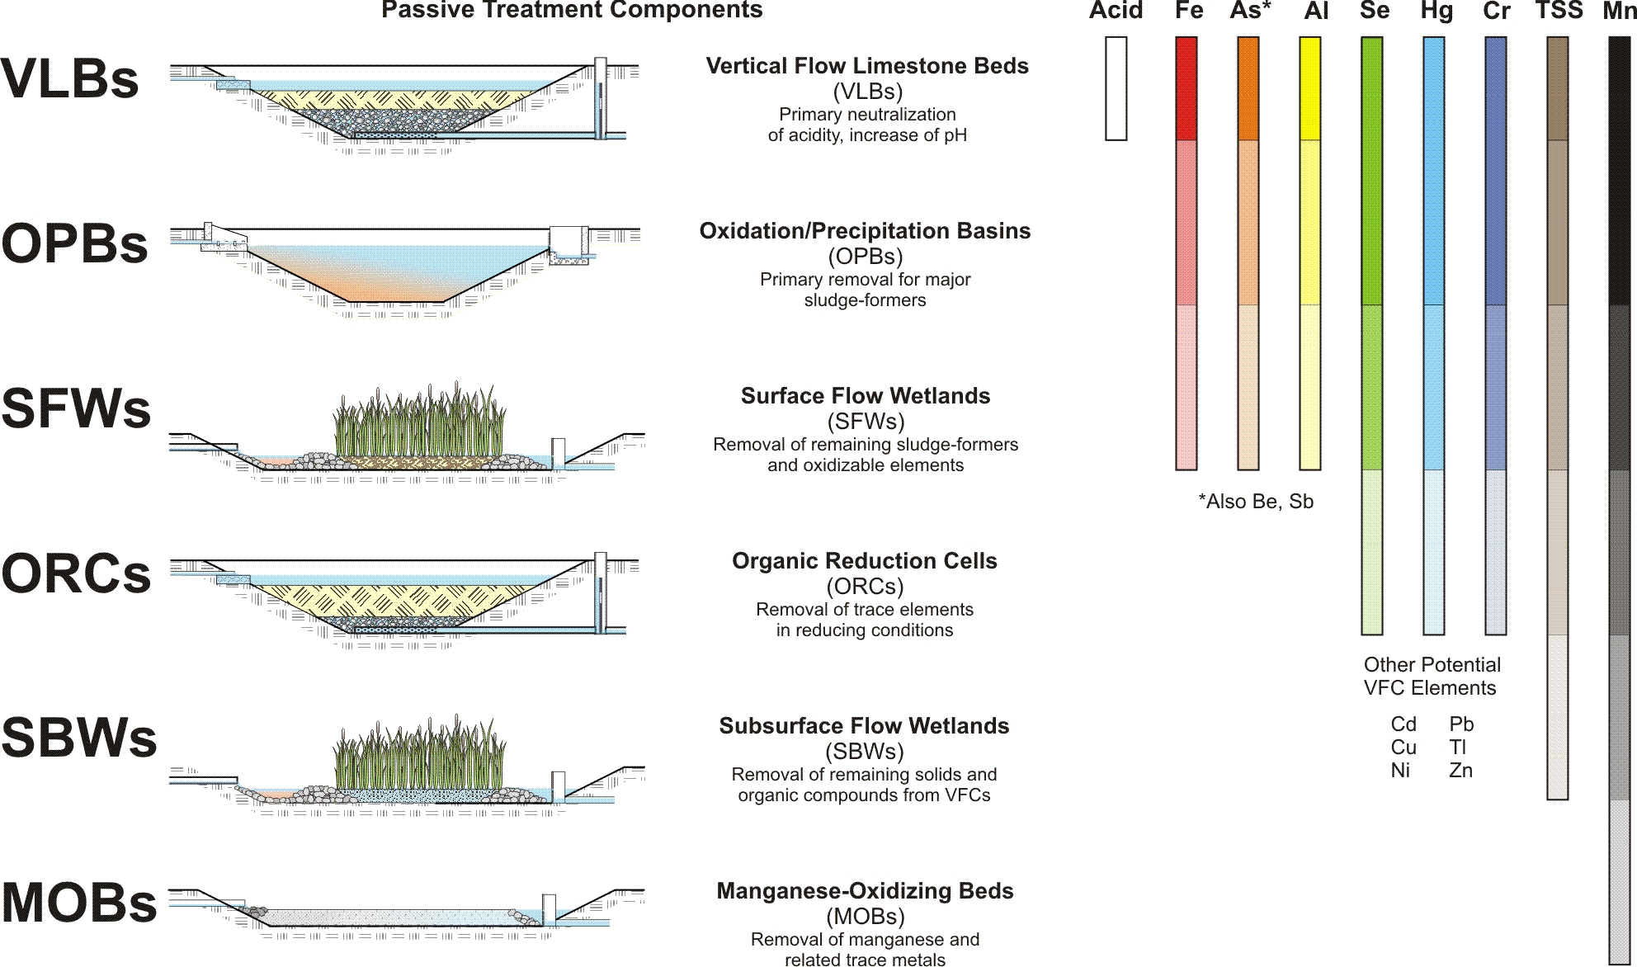
PERT Treatment Approach
Water &
Wetlands Consulting
Water’s Edge Hydrology

Slide 9
Constructed Wetland System Evolution
1987 - 2011
Water &
Wetlands Consulting
Water’s Edge Hydrology

Slide 10
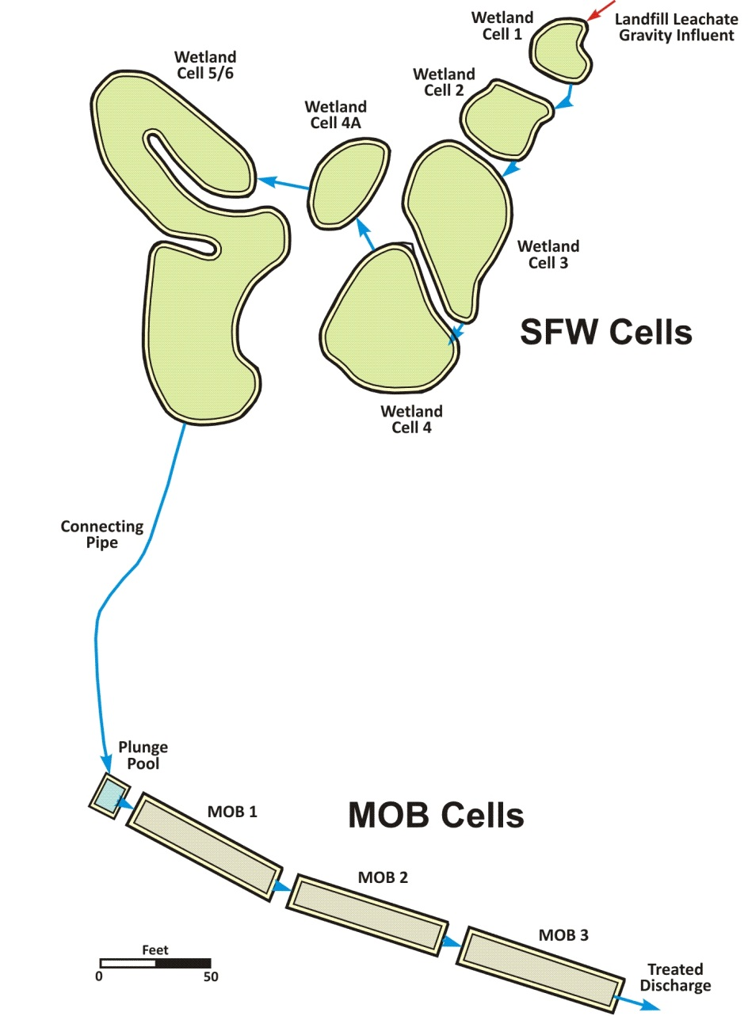
Albright System
1987
CCR leachate and AMD
Treating for pH, Fe, Mn
“Free-form” wetland cell designs in 1987
New SFW cells added in 1992 to improve Mn removal
MOBs added in 1996 for final compliance
Water &
Wetlands Consulting
Water’s Edge Hydrology

Slide 11
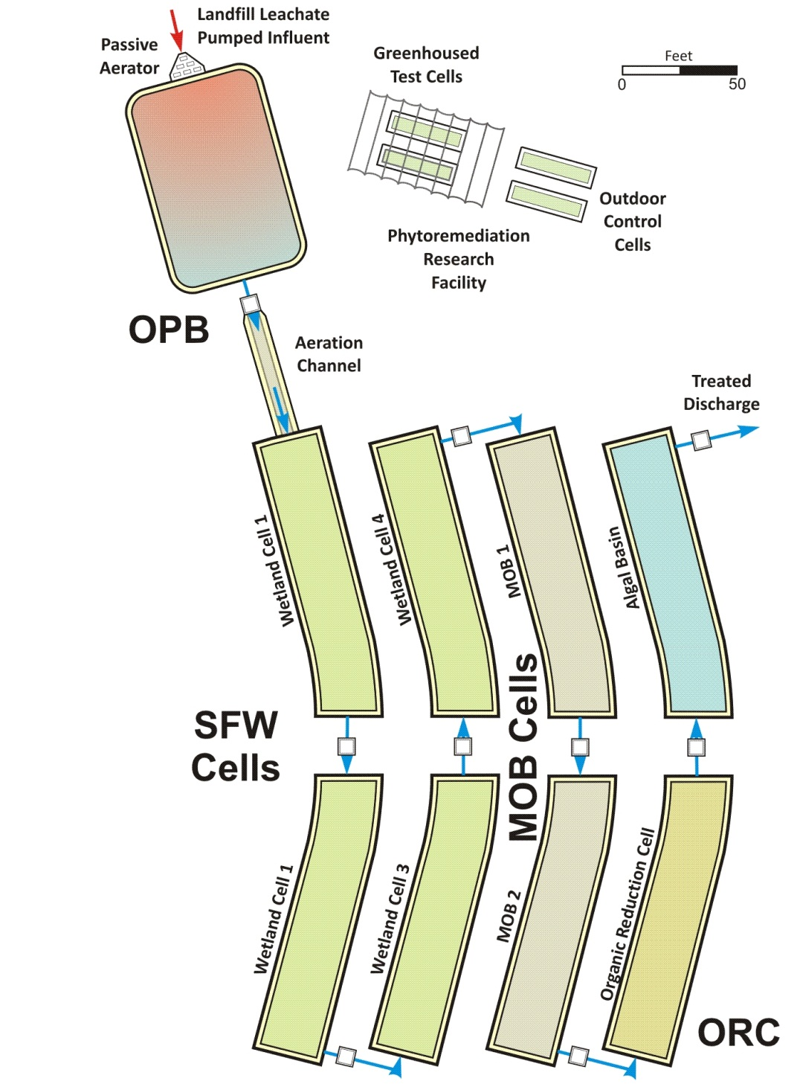
Springdale System
1995
CCR leachate and AMD
Treating for pH, Al, As, B, Fe, Mn, Se, TSS
Research and compliance project with EPRI
Tested multiple technologies together
Multiple award winner – formed basis of PERT
Water &
Wetlands Consulting
Water’s Edge Hydrology

Slide 12
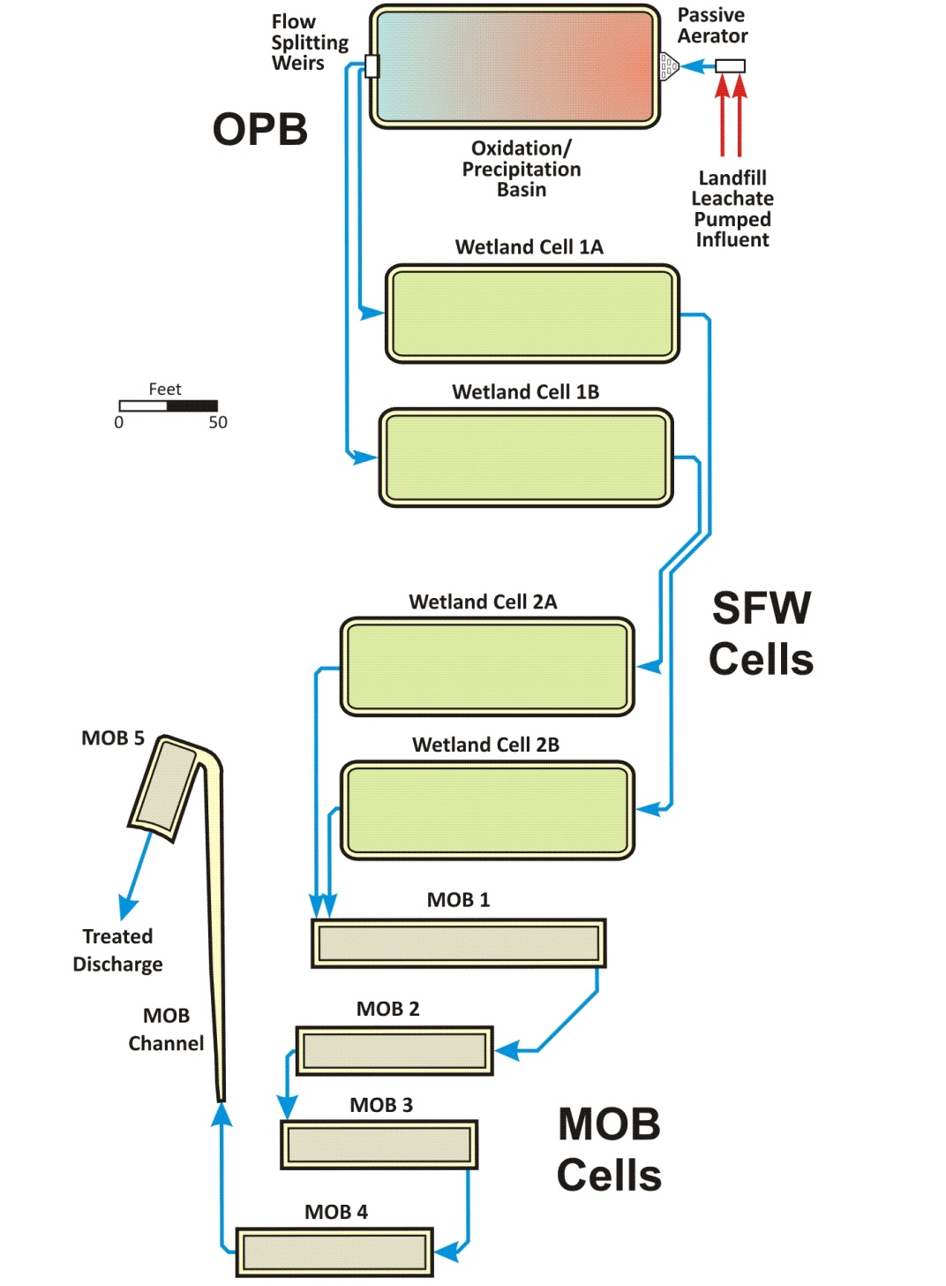
Hatfield System
2000
CCR leachate and AMD
Treating for pH, Al, As, Fe, Mn, Tl, TSS
First full PERT application
SFW cells used for polishing rather than primary Fe treatment
Refined MOB sizing
criteria, regular cell
outlines
Water &
Wetlands Consulting
Water’s Edge Hydrology

Slide 13
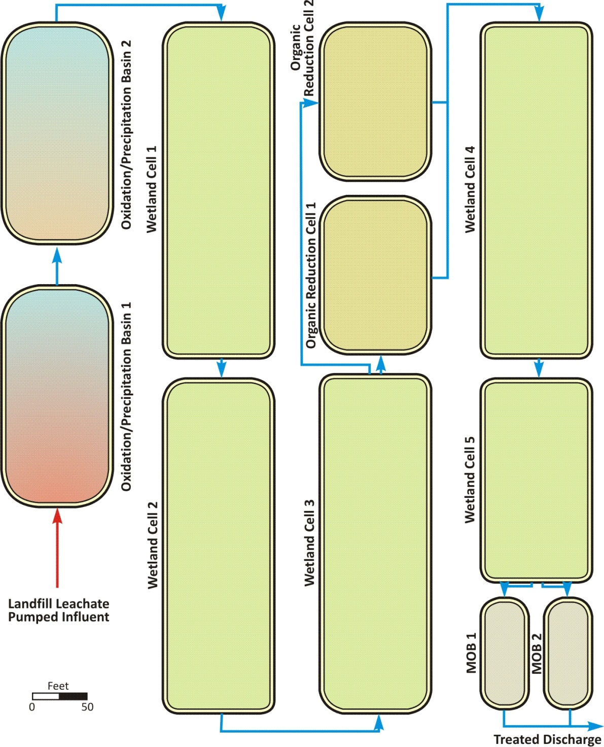
Harrison System
2003
CCR leachate and AMD
Treating for pH, Al, As, Cr⁶⁺, Fe, Mn, Se, TSS
First use of ORCs for Cr⁶⁺ and Se
Secondary SFWs used for solids control
Water &
Wetlands Consulting
Water’s Edge Hydrology

Slide 14
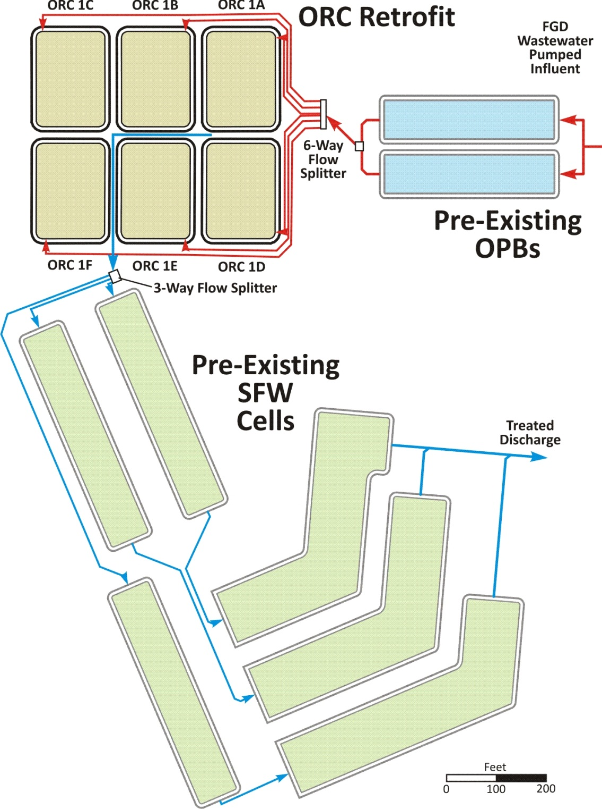
Marshall System
2011
Flue gas desulfuriza-tion (FGD) wastewater
Treating primarily for As, Fe, Hg, Se
Pre-existing SFWs had poor Se removal
3 SFWs replaced with 6 ORCs
Greatly enhanced Se & Hg removal
Water &
Wetlands Consulting
Water’s Edge Hydrology

Slide 15
Long-Term Performance
Manganese - Albright
Water &
Wetlands Consulting
Water’s Edge Hydrology

Slide 16
Long-Term Performance
Arsenic - Springdale
Water &
Wetlands Consulting
Water’s Edge Hydrology

Slide 17
Long-Term Performance
Selenium - Harrison
Water &
Wetlands Consulting
Water’s Edge Hydrology

Slide 18
System Component Performance
Selenium - Harrison
Water &
Wetlands Consulting
Water’s Edge Hydrology

Slide 19
Future Considerations
Vegetated wetlands will remain a key component of passive treatment systems
Proposed EPA utility wastewater guidelines recognize biological treatment as a compliance option
Biological systems are a low-cost, sustainable solution for wastewater remediation on remote and unstaffed sites
Exclusion of wildlife may become a consideration for future designs
Water &
Wetlands Consulting
Water’s Edge Hydrology

Slide 20
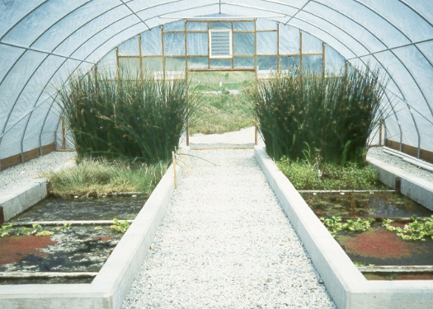
Wetland of the Future?
Water &
Wetlands Consulting
Water’s Edge Hydrology

Slide 21
Questions & Discussion
Kevin L. Hoover, PG, PHGW, PWS
Principal/Senior Scientist
Water & Wetlands Consulting, LLC
1109 Buchanan Valley Road
Orrtanna, PA 17353
717-778-7859
khoover@waterandwetlands.com

Slide 22
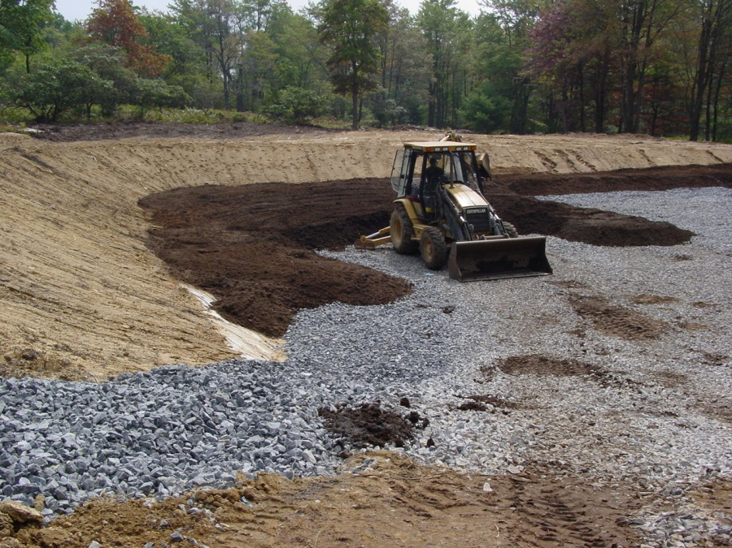
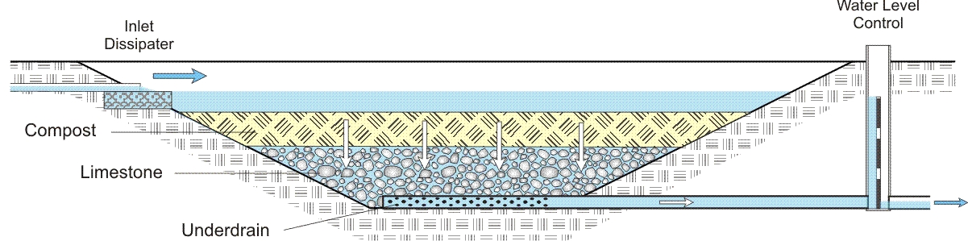
Vertical Flow Limestone Beds (VLBs)
Used for acidity removal
Basal limestone bed with top cover of organic compost
Generate alkalinity from limestone and sulfate reduction
Also remove Fe and Al, but this can cause clogging
Water &
Wetlands Consulting
Water’s Edge Hydrology

Slide 23
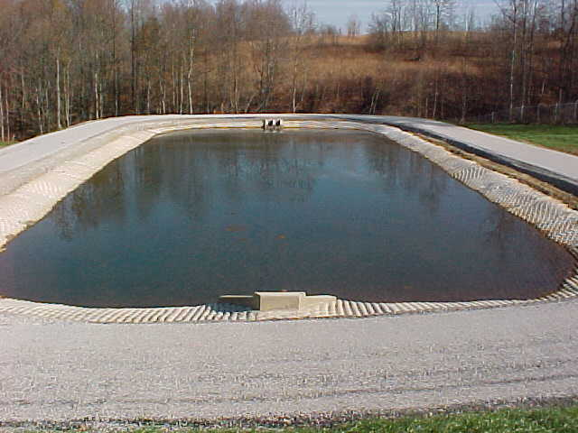
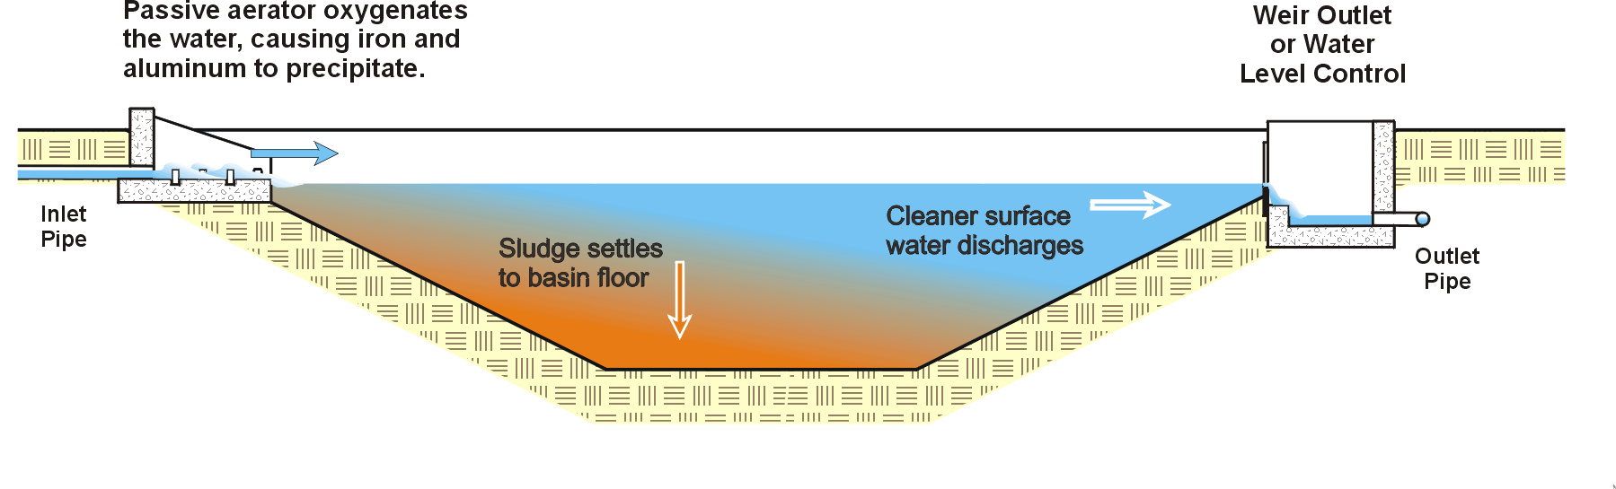
Oxidation/Precipitation Basins (OPBs)
Used for aerobic precipitation of metals and sludge storage
Deep open water basins, usually with 24+ hours detention
Aeration provided at inlet
Work well for Fe and Al, also remove As with Fe co-precipitation
Water &
Wetlands Consulting
Water’s Edge Hydrology

Slide 24
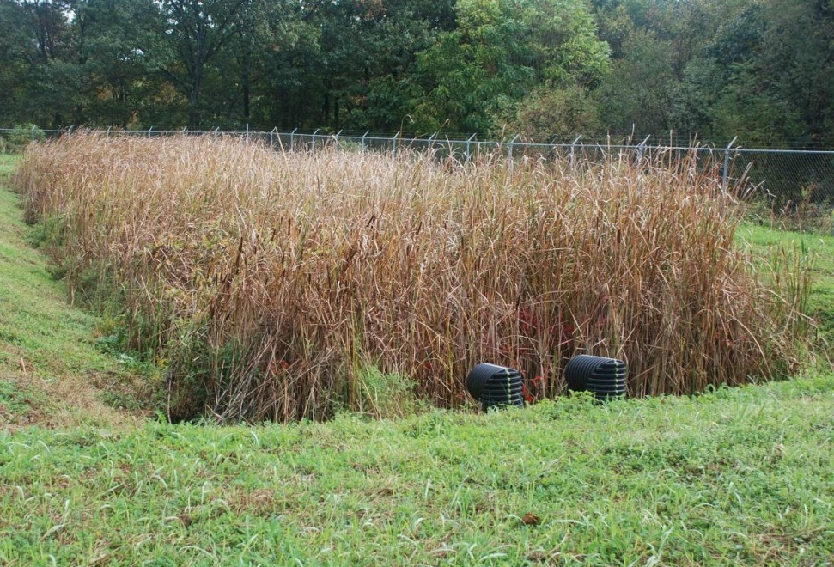
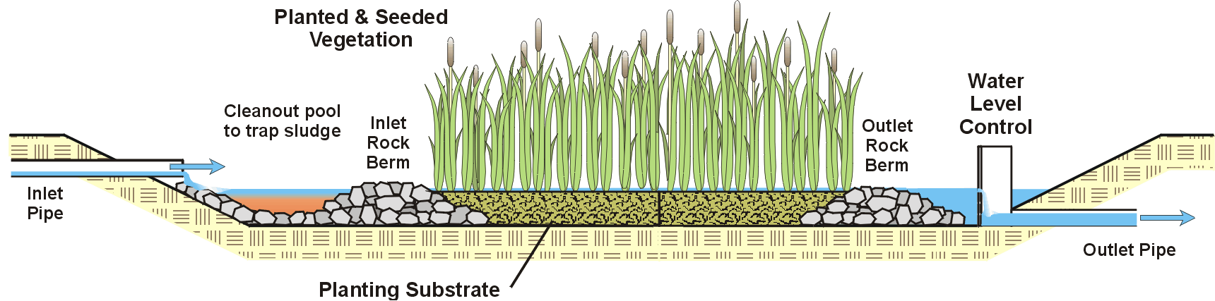
Surface & Subsurface Flow Wetlands (SFWs, SBWs)
Effective for polishing many parameters
Contain aerobic and anaerobic components
Blended organic substrate and shallow water for SFWs
Porous substrate for SBWs
Work best for residual Fe, Al, and solids (TSS) removal
Water &
Wetlands Consulting
Water’s Edge Hydrology

Slide 25
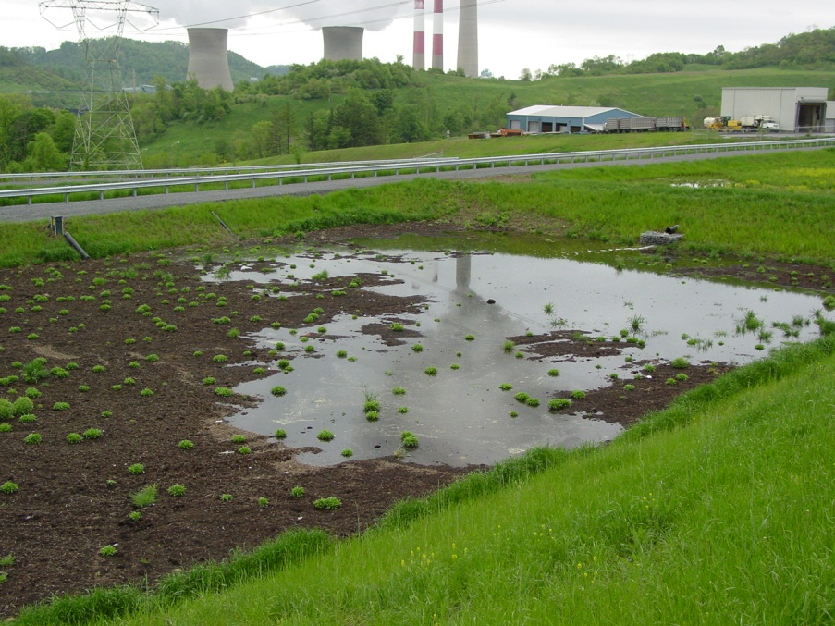
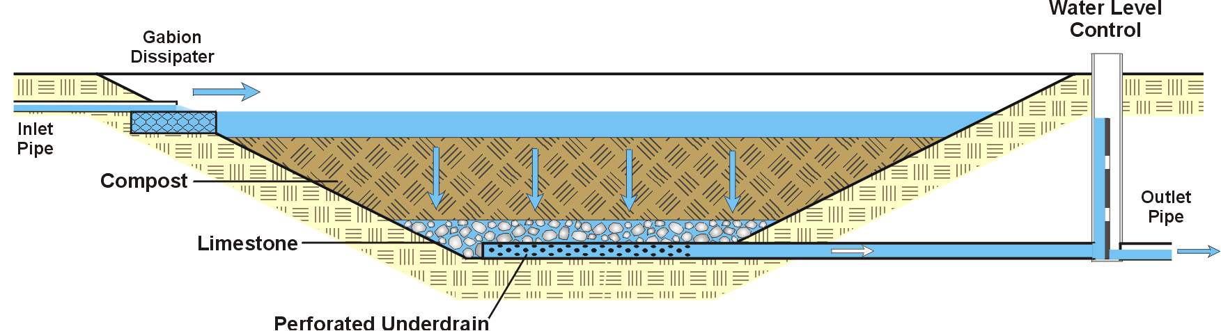
Organic Reduction Cells (ORCs)
Similar to VFWs, but with a thick top organic bed
Create strongly reducing conditions
Effective for Se, Hg, Cr⁶⁺, and others mobile in oxidizing conditions
Should be followed by SFWs or SBWs for solids polishing
Water &
Wetlands Consulting
Water’s Edge Hydrology

Slide 26
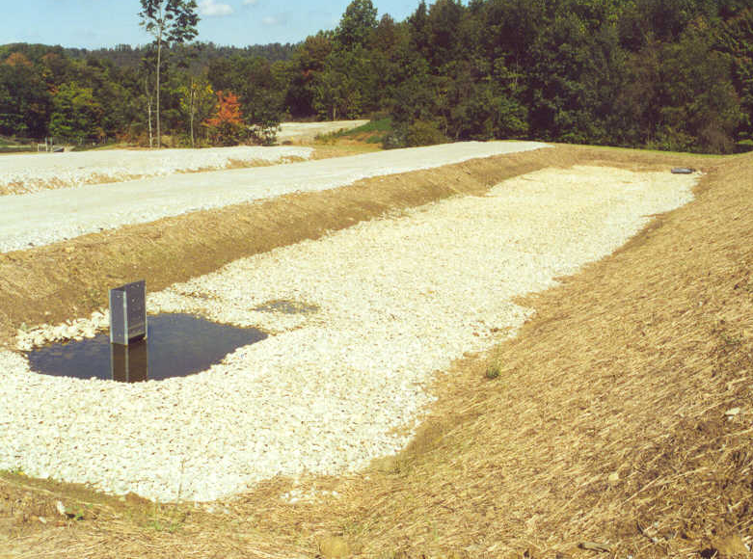
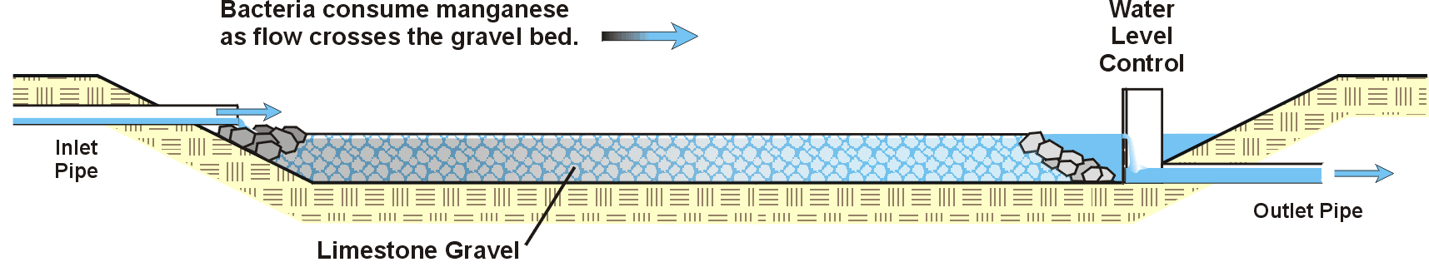
Manganese-Oxidizing Beds (MOBs)
Shallow basins filled with 1 – 2 feet of gravel
Create growth surface for manganese-oxidizing bacteria
Mn deposited as pyrolusite (MnO₂)
Require low influent Fe – placed at end of system
Water &
Wetlands Consulting
Water’s Edge Hydrology

